Slide 1
COT5615: Math for Intelligent Systems I
Anand Rangarajan
Lecture 26

Slide 2
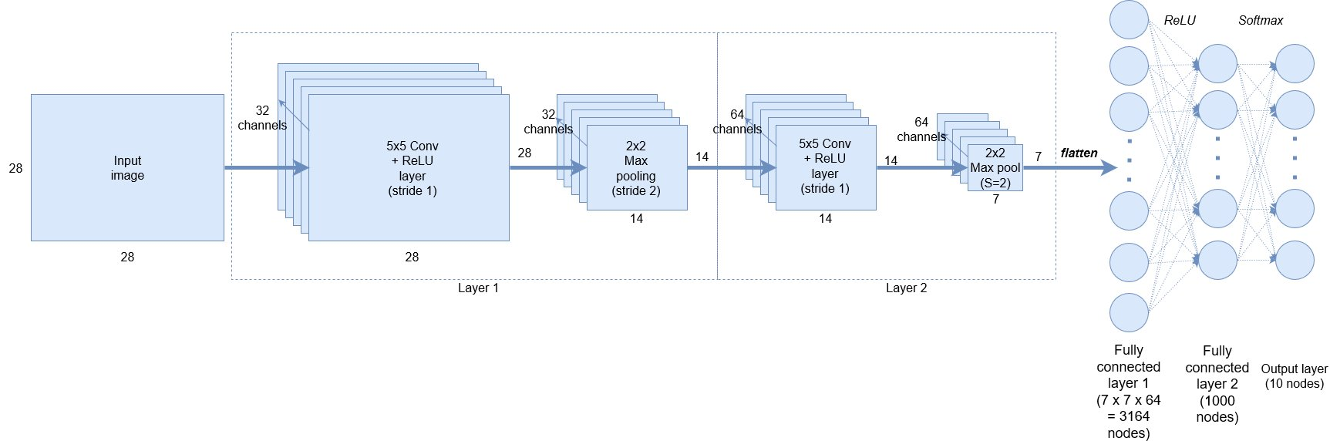
CNN Block Diagram

Slide 3
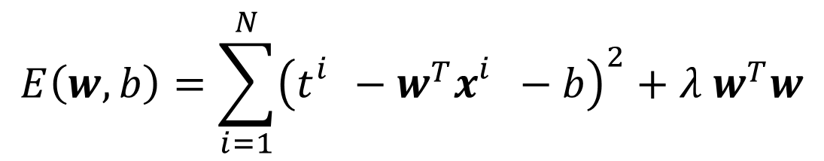
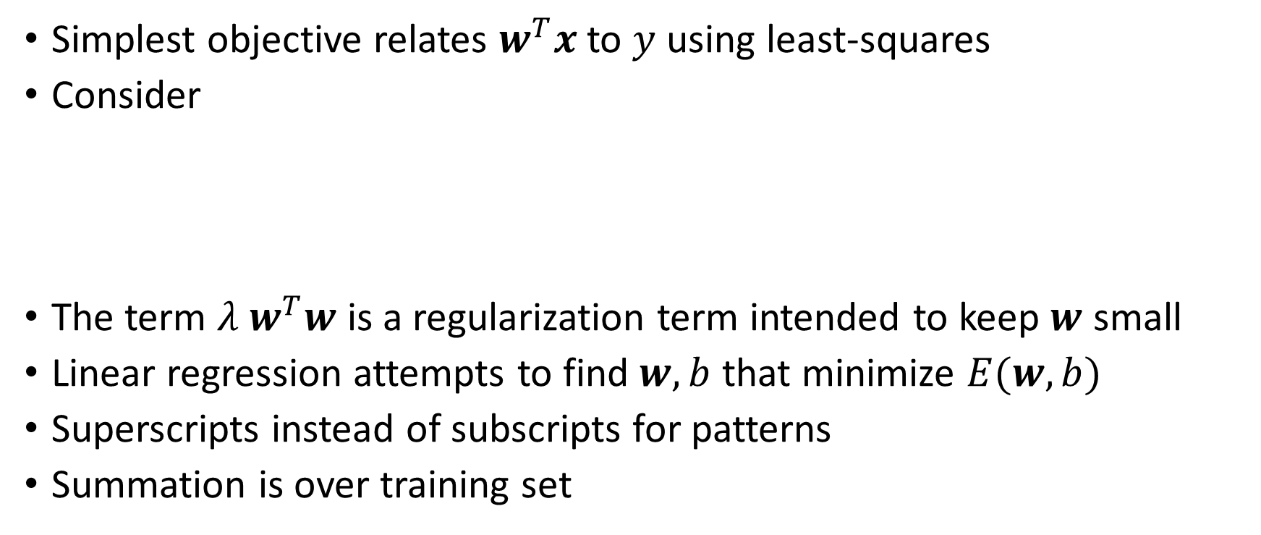
Linear Classifier Objective
Simplest objective relates $w^{T}x$ to $y$ using least-squares
Consider
The term $λ w^{T}w$ is a regularization term intended to keep $w$ small
Linear regression attempts to find $w,b$ that minimize $E(w,b)$
Superscripts instead of subscripts for patterns
Summation is over training set
$$E\left(w,b\right)=\sum_{i=1}^{N}{{\left(t_{}^{i}−w^{T}x_{}^{i}−b\right)}^{2}}+λ w^{T}w$$

Slide 4






The XOR problem
$$x_{2}$$
$$(0,1)$$
$$(1,1)$$
o
x
x
o
$$(0,0)$$
$$(1,0)$$
$$x_{1}$$
No Linear Classifier (in 2D)

Slide 5
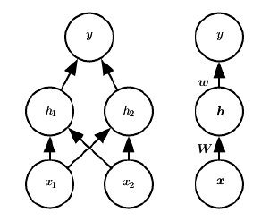


Feedforward networks
$$h_{1}={\max\left\{0,{W_{11}x}_{1}+W_{12}x_{2}+c_{1}\right\}}_{}$$
$$h_{2}=\max\left\{0,W_{22}x_{1}+W_{22}x_{2}+c_{2}\right\}$$
$$y=w_{1}h_{1}+w_{2}h_{2}+b$$
Note: $W$ and $w$ similar to text but transposed

Slide 6
















The actual feedforward network
$$c_{1}$$
$$+1$$
$$+1$$
$$b$$
$$c_{2}$$
$$W_{11}$$
$$w_{1}$$
$$x_{1}$$
$$h_{1}$$
$$y$$
$$W_{21}$$
$$W_{12}$$
Biases not shown in book
Platforms usually add bias nodes silently
$$x_{2}$$
$$h_{2}$$
$$w_{2}$$
$$W_{22}$$

Slide 7
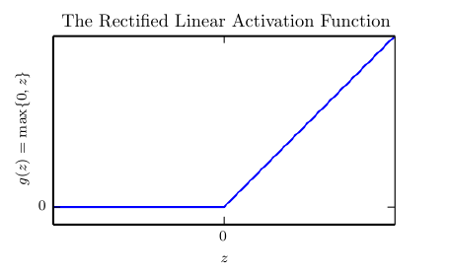

Rectified Linear Unit (ReLU)
$$g\left(z\right)=\max\left\{0,z\right\}$$
Many other activation functions

Slide 8
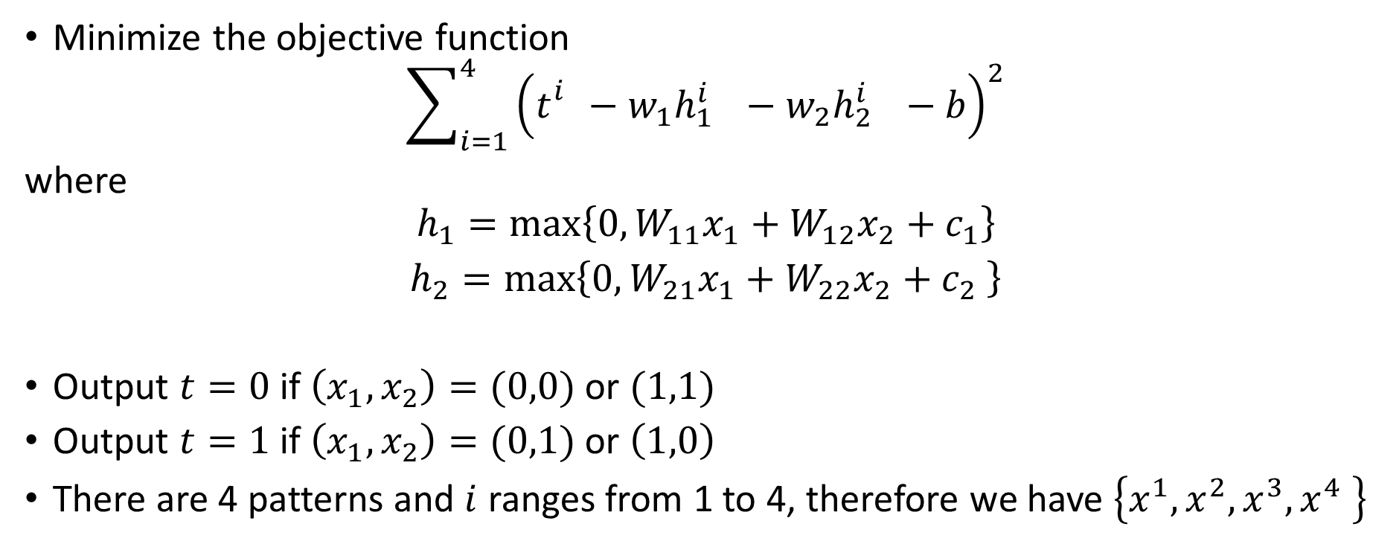
Solution to XOR
Minimize the objective function
$$\sum_{i=1}^{4}{{\left(t_{}^{i}−w_{1}h_{1_{}}^{i}−w_{2}h_{2_{}}^{i}−b\right)}^{2}}$$
where
$$h_{1}=\max\left\{0,W_{11}x_{1}+W_{12}x_{2}+c_{1}\right\}$$
$h_{2}=\max\left\{0,W_{21}x_{1}+W_{22}x_{2}+c_{2} \right\}$
Output $t=0$ if $\left(x_{1},x_{2}\right)=(0,0)$ or $(1,1)$
Output $t=1$ if $\left(x_{1},x_{2}\right)=(0,1)$ or $\left(1,0\right)$
There are 4 patterns and $i$ ranges from 1 to 4, therefore we have $\left\{x^{1},x^{2},x^{3},x^{4} \right\}$

Slide 9
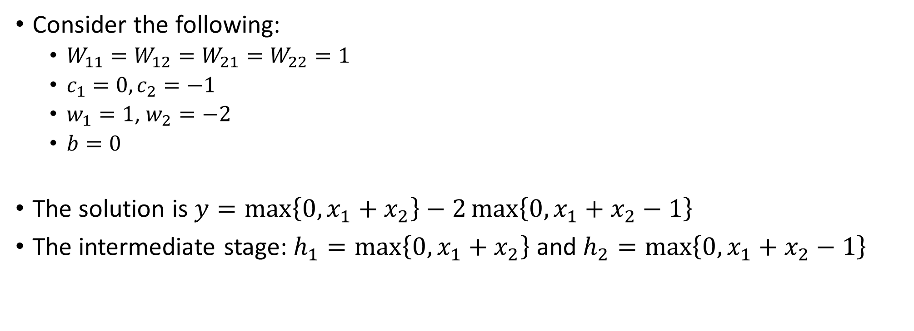
Solution to XOR (contd.)
Consider the following:
$W_{11}=W_{12}=W_{21}=W_{22}=1$
$c_{1}=0, c_{2}=−1$
$w_{1}=1$, $w_{2}=−2$
$b=0$
The solution is $y=\max\left\{0,x_{1}+x_{2}\right\}−2\max\left\{0,x_{1}+x_{2}−1\right\}$
The intermediate stage: $h_{1}=\max\left\{0,x_{1}+x_{2}\right\}$ and $h_{2}=\max\left\{0,x_{1}+x_{2}−1\right\}$

Slide 10











Visualizing the intermediate stage
$$x_{2}$$
$$h_{2}$$
$$(0,1)$$
$$(1,1)$$
$$(2,1)$$
o
x
x
x
o
x
o
$$(0,0)$$
$$(1,0)$$
$$x_{1}$$
$$(0,0)$$
$$(1,0)$$
$$h_{1}$$

Slide 11
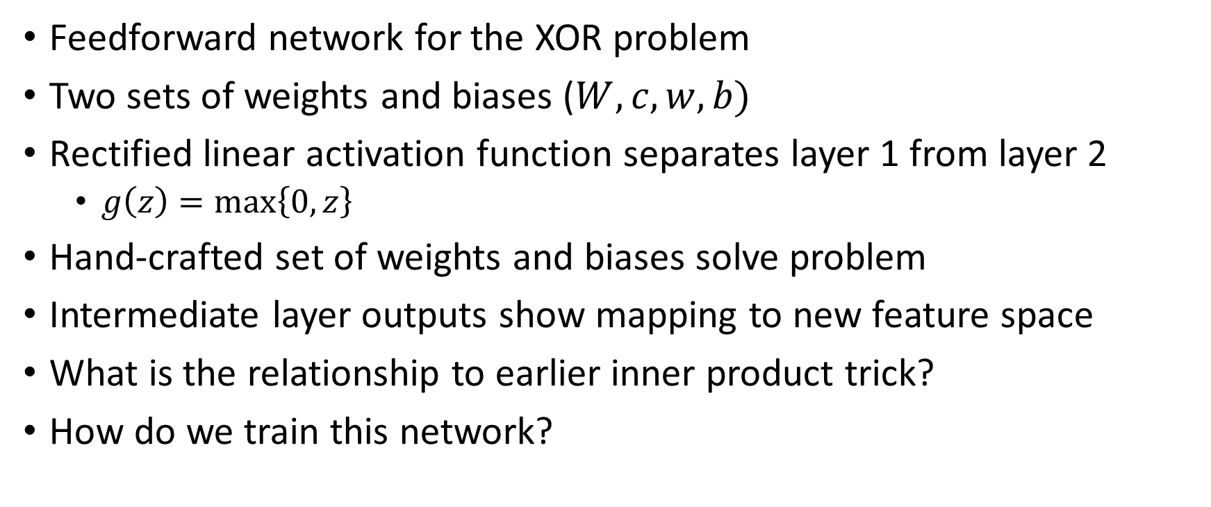
Summary
Feedforward network for the XOR problem
Two sets of weights and biases ($W,c,w,b)$
Rectified linear activation function separates layer 1 from layer 2
$g\left(z\right)=\max\left\{0,z\right\}$
Hand-crafted set of weights and biases solve problem
Intermediate layer outputs show mapping to new feature space
What is the relationship to earlier inner product trick?
How do we train this network?

